Slide 1

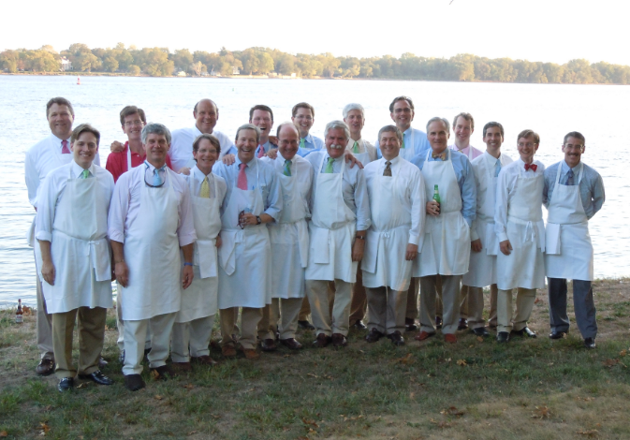
The Tonics featuring Sam Marshall
Friday, July 29th
8:00 PM
Location:The Fishers Island Club
Tickets: $25 each
Island Concerts
Presents
For Tickets:
Island Concerts
P.O. Box 81
Fishers Island, N.Y. 06390
Phone (631) 788-7469
fiislandconcerts@yahoo.com

